Slide 1
Anomaly detection in graphs - past, present and future.
Leman Akoglu CMU
Mary McGlohon Google
Christos Faloutsos CMU

Slide 2
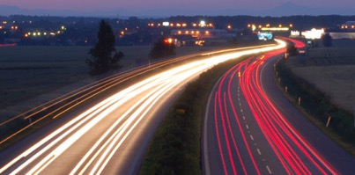
Roadmap
Introduction – Motivation
OddBall
Last 10 years
Future
Q1) definition?
Q2) automation?
Q3) next steps?

Slide 3
Future – parting thoughts
Q1) Definition of anomaly?
A) “… strange/remote/unlikely, wrt our biases/priors”
Q2) can we automate it?
A) no, but: look for better models/biases/priors
Q3) next steps?
A) cross-disciplinarity -> new+better models

Slide 4
Future – parting thoughts
Q1) Definition of anomaly?
A) “… strange/remote/unlikely, wrt our biases/priors”
Q2) can we automate it?
A) no, but: look for better models/biases/priors
Q3) next steps?
A) cross-disciplinarity -> new+better models

Slide 5
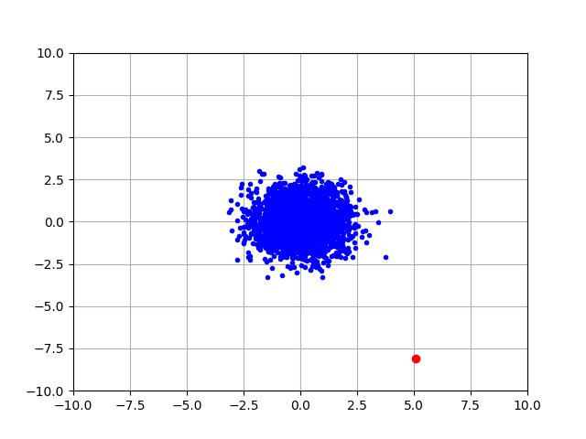
Q1) definition
“an observation which deviates so much from the other observations as to arouse suspicions that it was generated by a different mechanism”
D. M. Hawkins. Identification of outliers, volume 11. Springer, 1980.

Slide 6
Q1) definition
‘deviation from the common rule’
https://www.merriam-webster.com/dictionary/anomaly

Slide 7
Q1) definition
‘deviation from the common rule’
https://www.merriam-webster.com/dictionary/anomaly
But: How to spot rules?

Slide 8
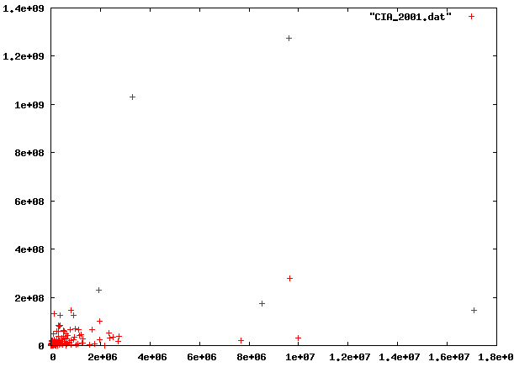
Q1: rules?

Slide 9
Q1: rules?

Slide 10
Q1: rules?
population
World countries
area

Slide 11
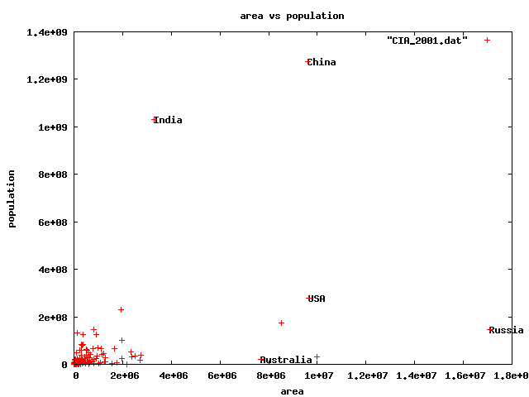
Q1) rules?
🇨🇳
🇮🇳
🇱🇷
🇷🇺

Slide 12
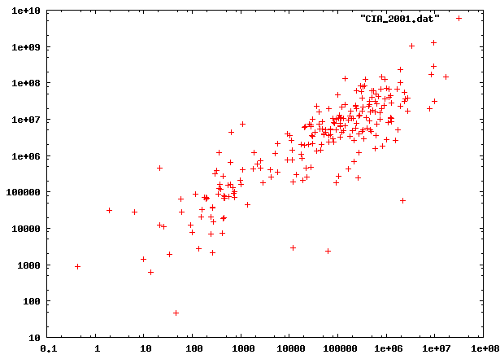
Q1) rules?

Slide 13
Q1) rules?

Slide 14
Q1) rules?

Slide 15
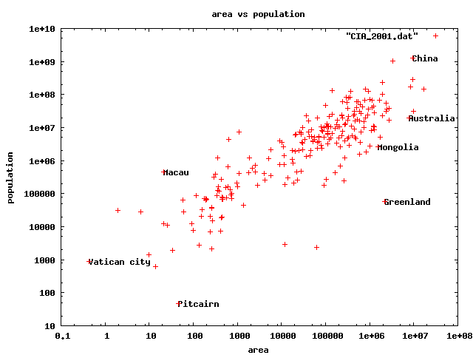
Q1) rules
0.5km²
82 football fields
47 residents(!)

Slide 16
Q1) rules?

Slide 17
Q1) definition
‘deviation from the common rule’*
https://www.merriam-webster.com/dictionary/anomaly
* Wrt our rule-types(s)/ biases/ axis-scales
But: How to spot rules?

Slide 18

Q1) definition
Patterns anomalies

Slide 19
Roadmap
Introduction – Motivation
OddBall
Last 10 years
Future
Q1) definition?
Q2) automation?
Q3) next steps?

Slide 20
Future – parting thoughts
Q1) Definition of anomaly?
A) “… strange/remote/unlikely, wrt our biases/priors”
Q2) can we automate it?
A) no, but: look for better models/biases/priors
Q3) next steps?
A) cross-disciplinarity -> new+better models

Slide 21
Q2) automation?
Q2.1
patterns
Q2.2
anomalies
compression

Slide 22
Q2) automation?
Q2.1
patterns
Q2.2
anomalies
compression

Slide 23
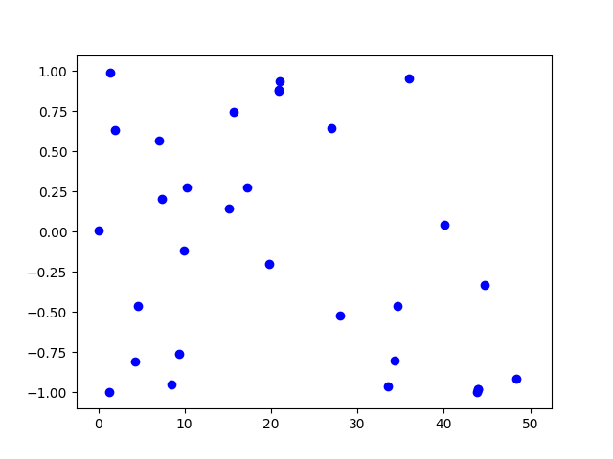
Q2.1) patterns <-> anomalies
Random?

Slide 24
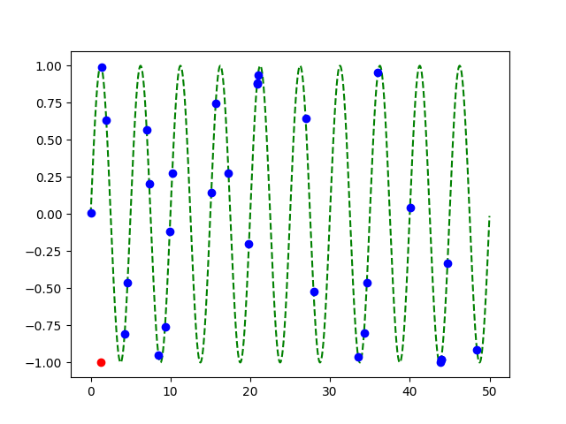
Q2.1) patterns <-> anomalies
Random?
Pattern!
+
Anomaly!

Slide 25
Q2) automation?
✓
Q2.1
patterns
Q2.2
anomalies
compression

Slide 26
Q2.2) patterns <-> compression
2 int per point
1 int per point
(plus 3 parm’s of sinusoid,
plus 2 int for outlier)

Slide 27
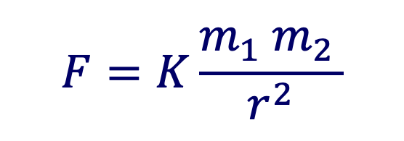
Q2.2) patterns <-> compression
Compression: @heart of science, e.g.:
$$F=K\frac{m_{1} m_{2 }}{r^{2}}$$
⬅️ Kepler ⬅️

Slide 28
compression is great – but …

Slide 29
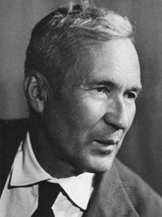
… optimal compression is undecidable!
Theorem*: for an arbitrary string x, computing its Kolmogorov complexity K(x) is undecidable
A.N. Kolmogorov
(*) E.g., [T. M. Cover and J. A. Thomas. Elements of Information Theory. John Wiley and Sons,1991, section 7.7]

Slide 30
… optimal compression is undecidable!
Theorem*: for an arbitrary string x, computing its Kolmogorov complexity K(x) is undecidable
EVEN WORSE
than NP-hard!
A.N. Kolmogorov
(*) E.g., [T. M. Cover and J. A. Thomas. Elements of Information Theory. John Wiley and Sons,1991, section 7.7]

Slide 31
… optimal compression is undecidable!
…which means there will be a chance to discover better data mining tools / models / patterns
-> job security ☺
-> job satisfaction ☺

Slide 32
Roadmap
Introduction – Motivation
OddBall
Last 10 years
Future
Q1) definition?
Q2) automation?
Q3) next steps?

Slide 33
Future – parting thoughts
Q1) Definition of anomaly?
A) “… strange/remote/unlikely, wrt our biases/priors”
Q2) can we automate it?
A) no, but: look for better models/biases/priors
Q3) next steps?
A) cross-disciplinarity -> new+better models

Slide 34
Examples of models
Fractals / self-similarity (Norway)
Logistic parabola (flies; covid)
Lotka-Volterra
Lorenz attractor (laser / synthetic )
Van der Pol / FitzHugh-Nagumo

Slide 35
Q3.1) models

Slide 36
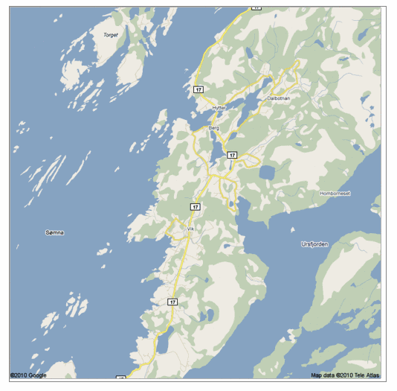
Q: Any pattern?

Slide 37
A: self similar!

Slide 38
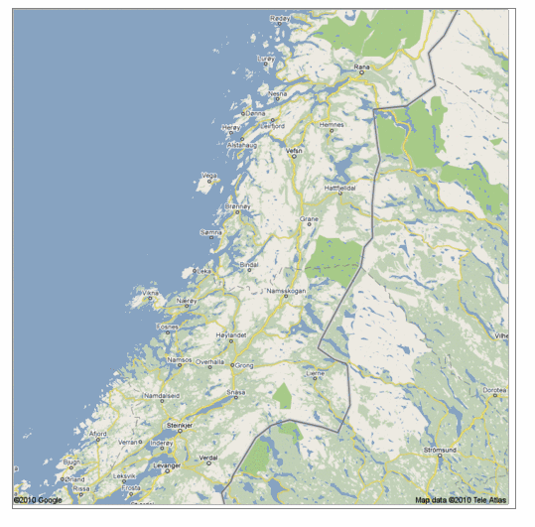
Real, self similar dataset

Slide 39
Real, self similar dataset

Slide 40
Real, self similar dataset

Slide 41
Real, self similar dataset

Slide 42
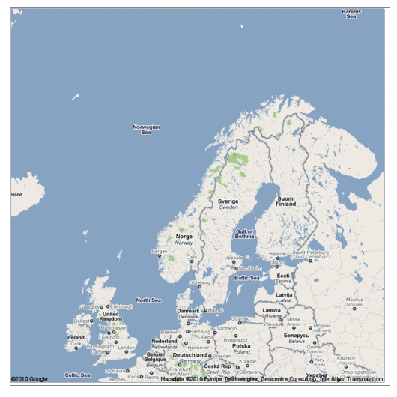
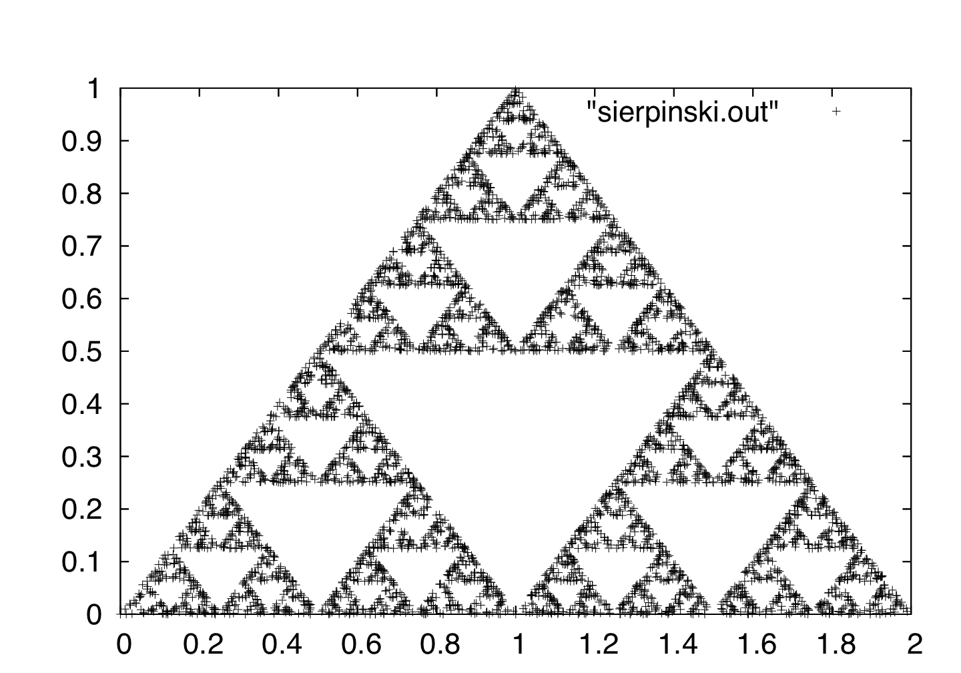
the red is true
origin: Norway
but most other coastlines are ‘self-similar’, too!

Slide 43
the red is true
origin: Norway
but most other coastlines are ‘self-similar’, too!
B. Mandelbrot
math.yale.edu

Slide 44
Q: Fractals and Graphs?

Slide 45
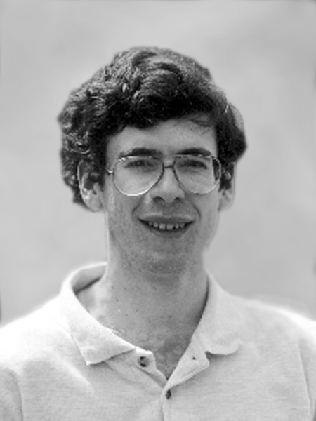
Fractals and Graphs
A: RMAT/Kronecker generators
D. Chakrabarti
J. Leskovec
J. Kleinberg
R-MAT: A Recursive Model for Graph Mining,
by D. Chakrabarti, Y. Zhan and C. Faloutsos,
SDM 2004, Orlando, Florida, USA
Realistic, Mathematically Tractable Graph Generation
and Evolution, Using Kronecker Multiplication,
by J. Leskovec, D. Chakrabarti, J. Kleinberg,
and C. Faloutsos, in PKDD 2005, Porto, Portugal

Slide 46
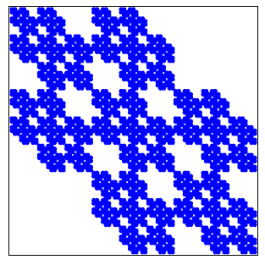
Kronecker Graphs
KDD dissertation award
[J. Leskovec, 2009]
PKDD test of time award, 2015
https://graph500.org/

Slide 47
Examples of models
✓
Fractals / self-similarity (Norway; Kronecker)
Logistic parabola (flies; covid)
Lotka-Volterra
Lorenz attractor (laser / synthetic )
Van der Pol / FitzHugh-Nagumo

Slide 48
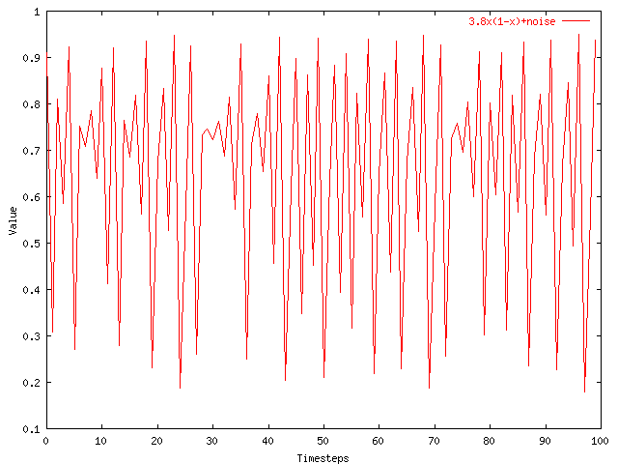
Q3.1) models?
Value
Time

Slide 49

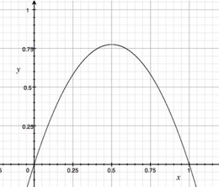
A3.1) Logistic parabola
Models population of flies [R. May/1976]
Logistic map
Time-series plot
Time t
Notes:
x_{t+1} = a x_t \cdot \left( 1-x_t \right )

Slide 50
A3.1) Logistic parabola
royalsociety.org
Models population of flies [R. May/1976]
Logistic map
= SI virus prop. model
~ Bass equation (market penetration)
Special case of Lotka-Volterra
[COVID-19: SIR]
Notes:
x_{t+1} = a x_t \cdot \left( 1-x_t \right )

Slide 51

Q3) How can we find better models?
A3) Domain experts / cross-disciplinarity

Slide 52
Future – parting thoughts
✓
Q1) Definition of anomaly?
A) “… strange/remote/unlikely, wrt our biases/priors”
Q2) can we automate it?
A) no, but: look for better models/biases/priors
Q3) next steps?
A) cross-disciplinarity -> new+better models
✓
✓

Slide 53







Thanks
Disclaimer: All opinions are mine; not necessarily reflecting the opinions of the funding agencies
Thanks to: NSF IIS-0705359, IIS-0534205,
CTA-INARC; Yahoo (M45), LLNL, IBM, SPRINT, Google, INTEL, HP, iLab

Slide 54
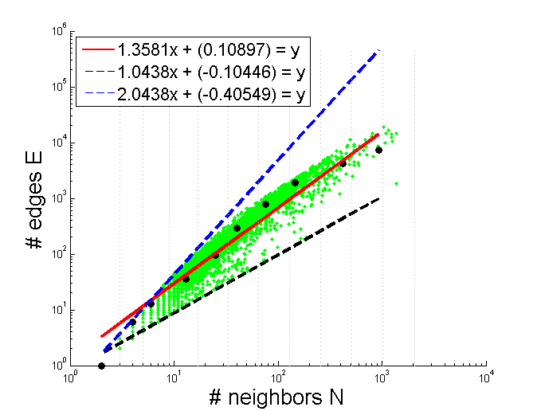
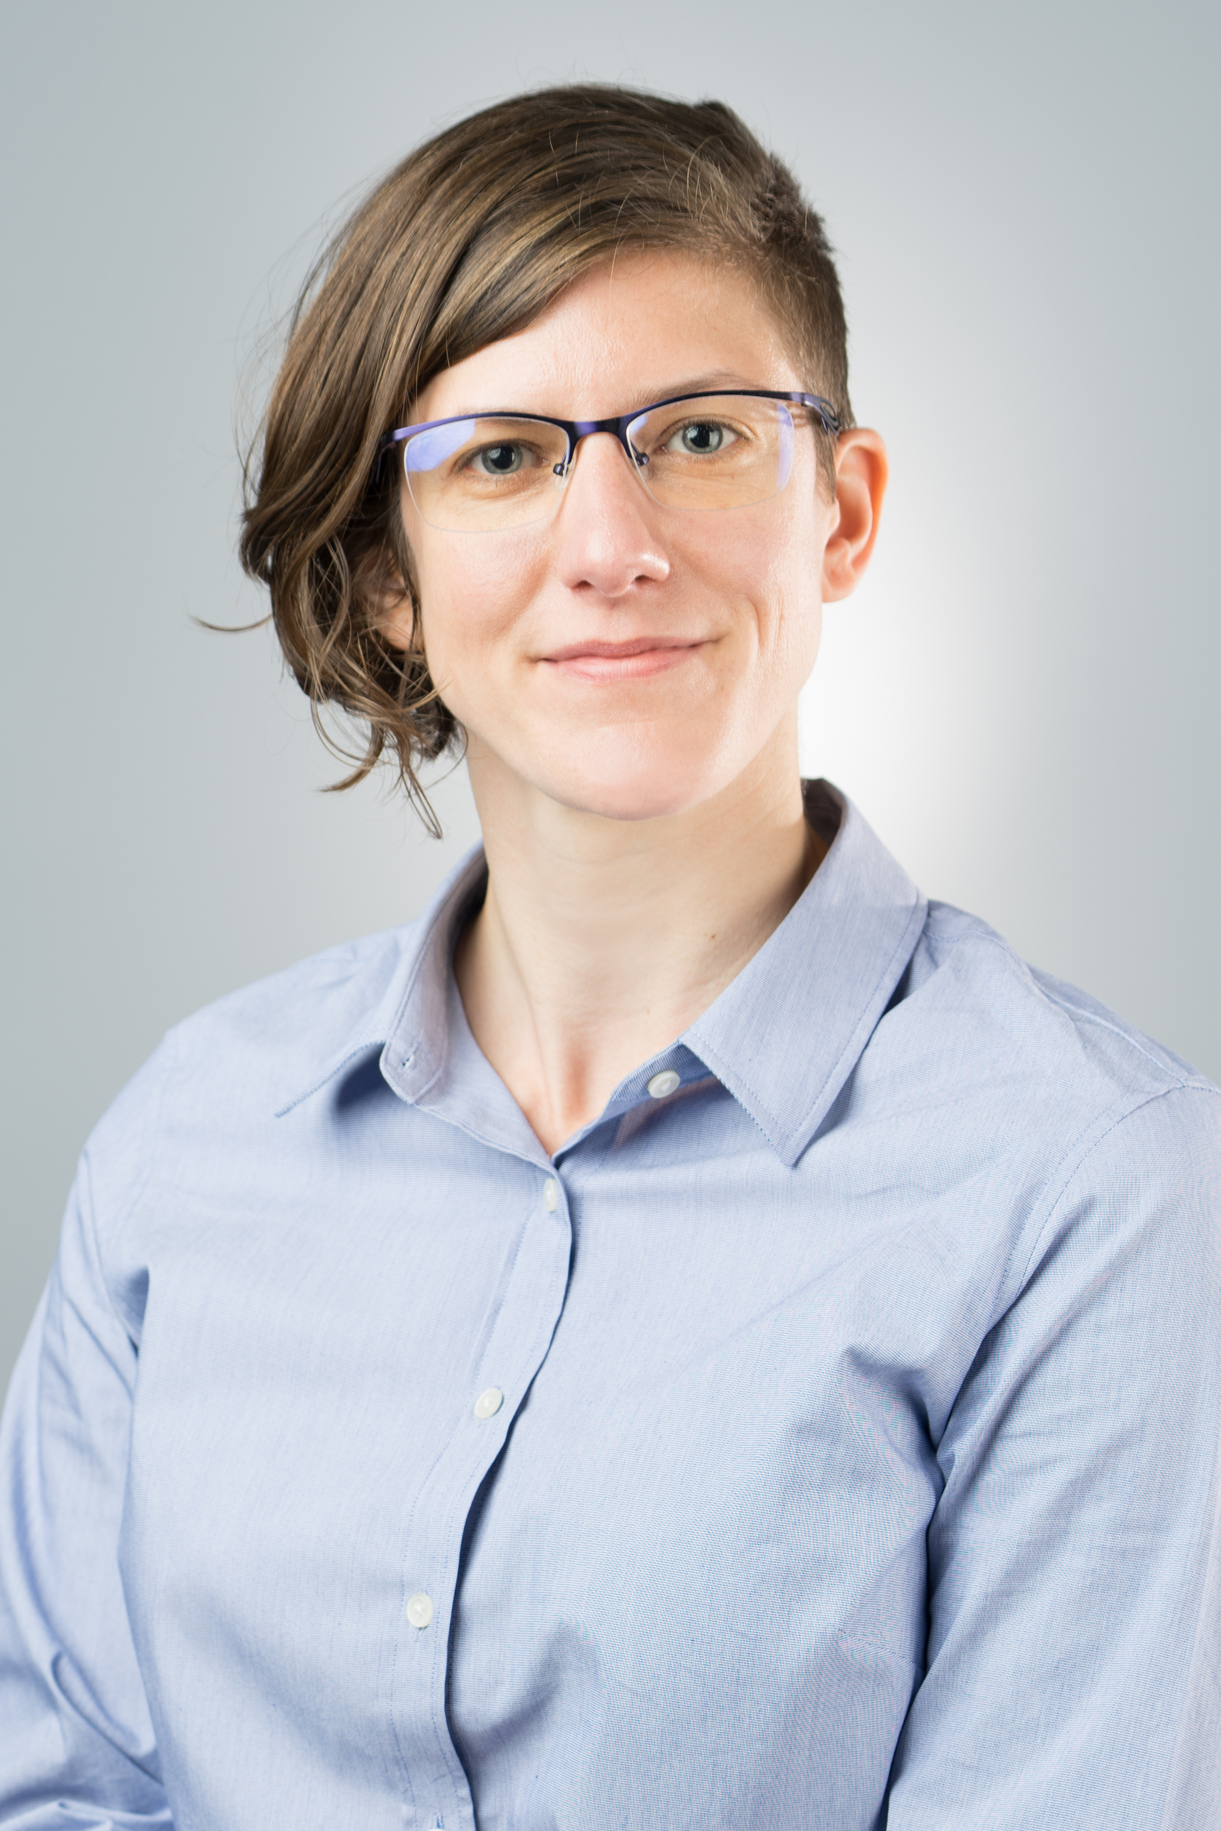
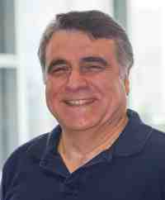
Thank you!

Slide 55
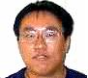
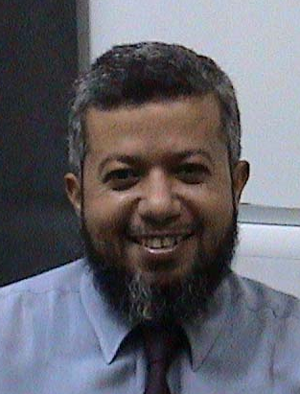
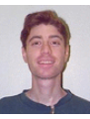
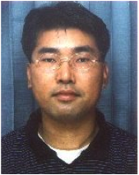
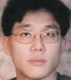
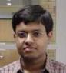
Academic ‘children’
King-Ip (David) Lin
Ibrahim Kamel
Flip Korn
Byoung-Kee Yi
Leejay Wu
Deepayan Chakrabarti

Slide 56
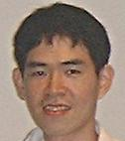
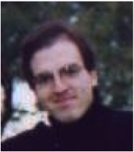
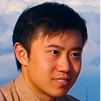
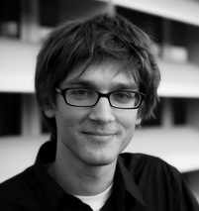

Academic ‘children’
Jia-Yu (Tim) Pan
Spiros Papadimitriou
Jimeng Sun
Jure Leskovec
Hanghang Tong

Slide 57
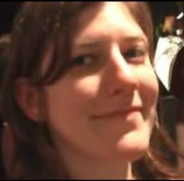
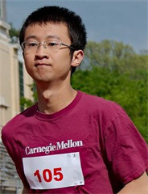
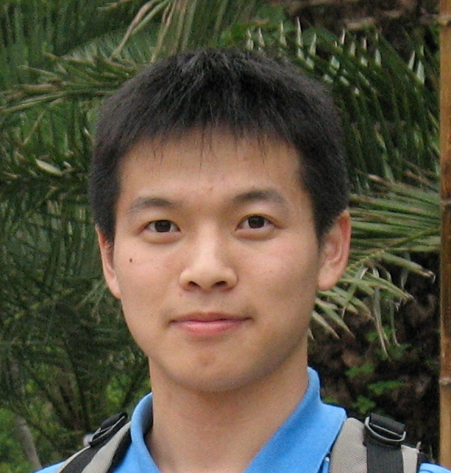
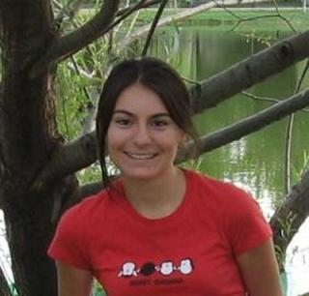


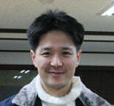
Academic ‘children’
Mary McGlohon
Fan Guo
Lei Li
Leman Akoglu
Dueng Horng (Polo) Chau
Aditya Prakash
U Kang

Slide 58
Outline
Graph Anomalies
Node-level
Feature-based
Proximity-based
Graph-level
Similarity-based
Subgraph-level
Community-based
Density-based
Community-based
Subgraph-based
Compression-based
Classes of problems
Main ideas

